Slide 1
MQTT Broker: Switch node comment node, Change node,Range node and Web Socket Node
Dr.V.Berlin Hency
Professor
SENSE
VIT Chennai

Slide 2
Objective
MQTT flow with switch node
MQTT flow with Switch node comment node,Change node,Range node
Flow using Web Socket Node

Slide 3
Command prompt
Cmd (Go to command prompt)
Node-red (to trigger node red)
http://127.0.0.1:1880/

Slide 4
Insert mqtt in node
Insert json node
Insert switch node
Insert debug node
Insert comment node

Slide 5
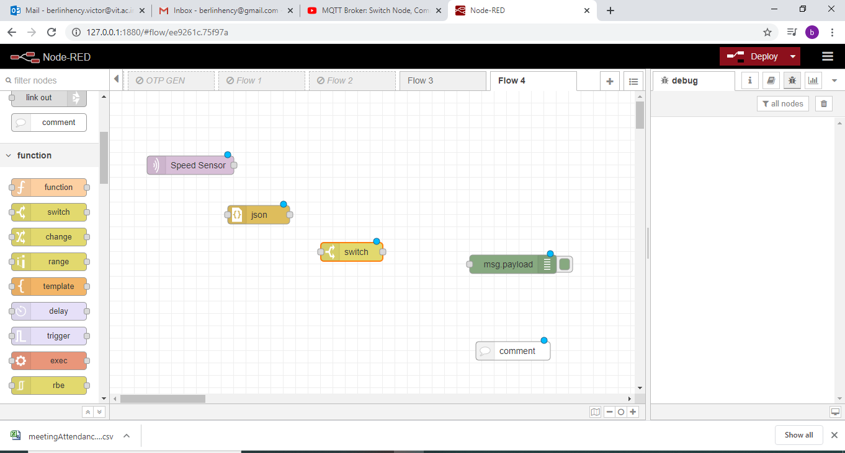

Slide 6
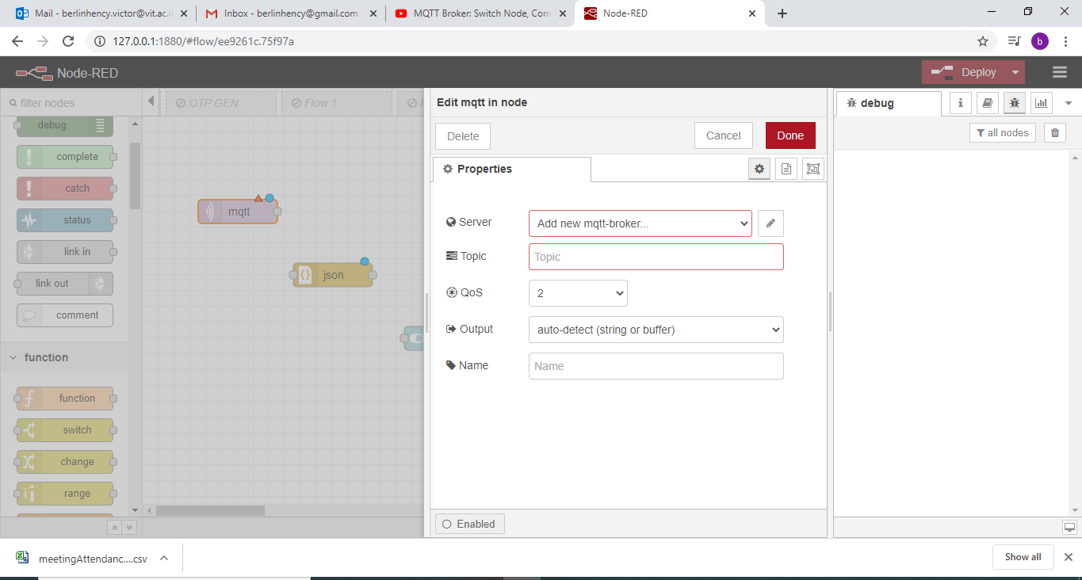
Configure mqtt in

Slide 7
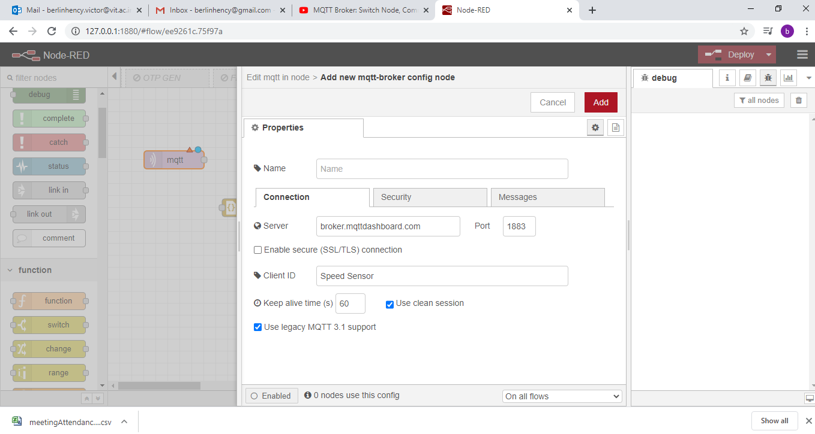

Slide 8
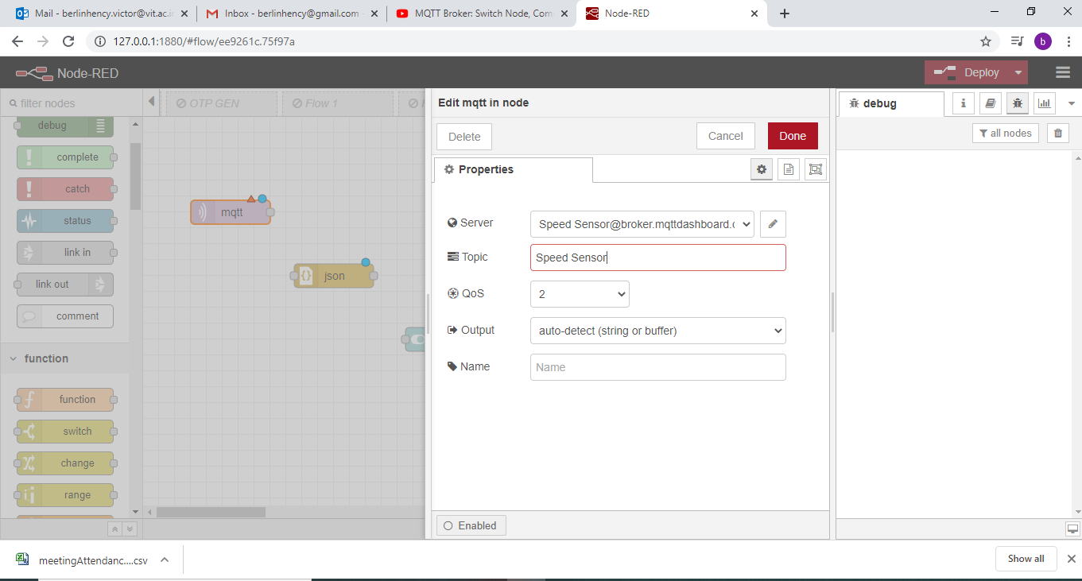

Slide 9
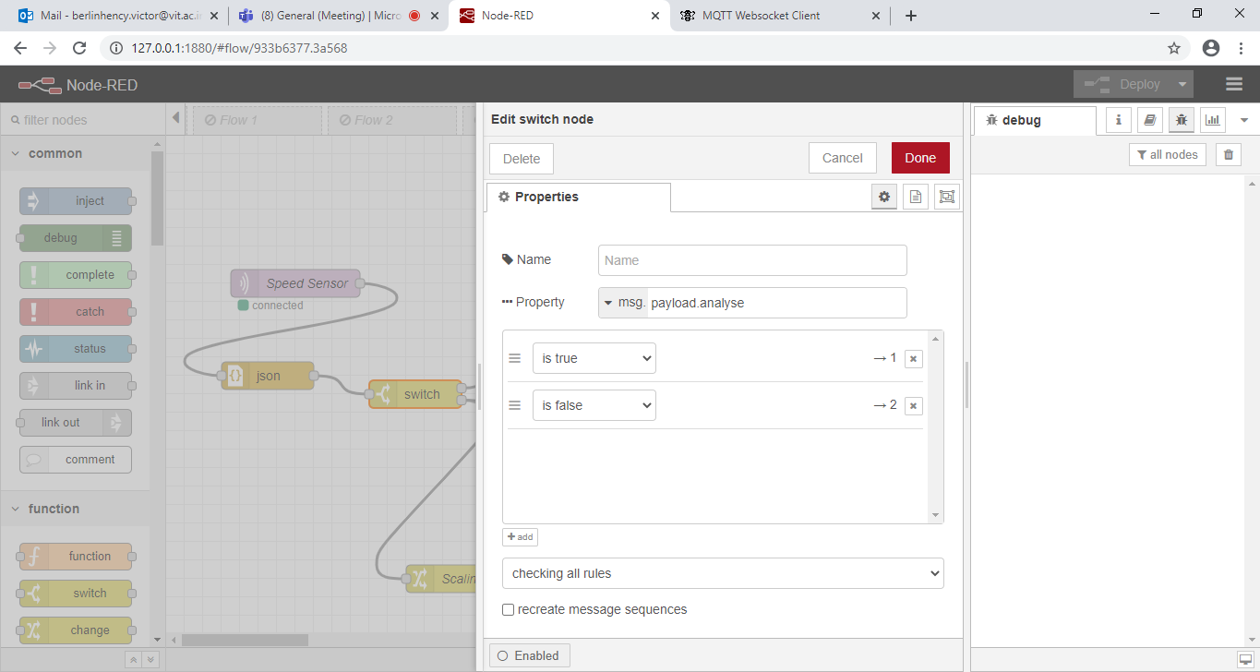
Configure Switch Node

Slide 10
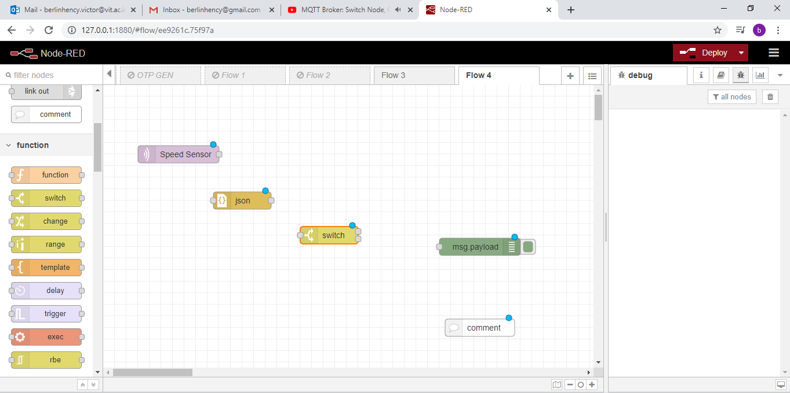
Switch node has two outputs

Slide 11
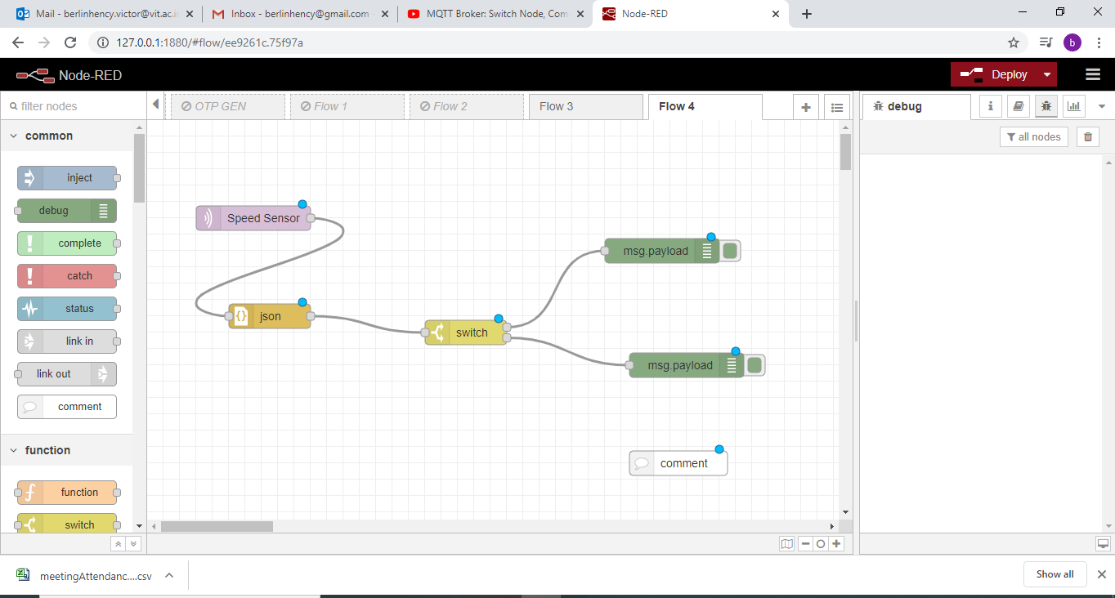

Slide 12
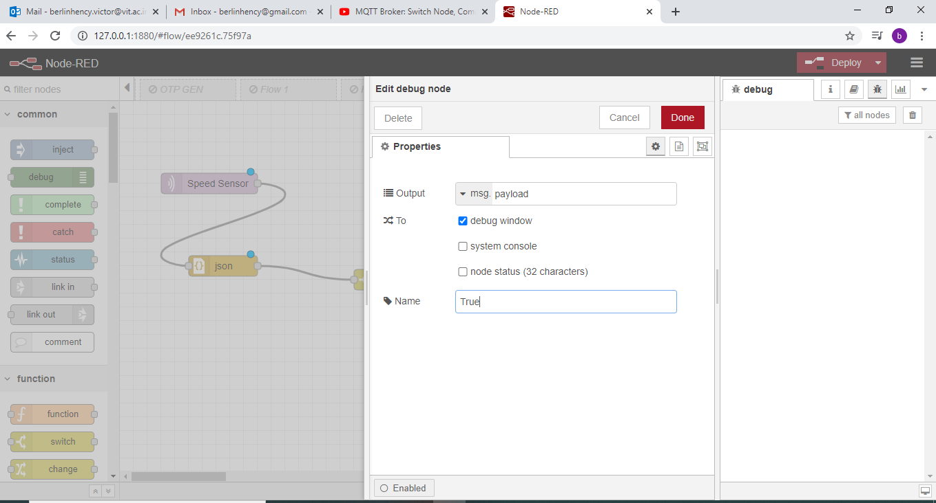

Slide 13
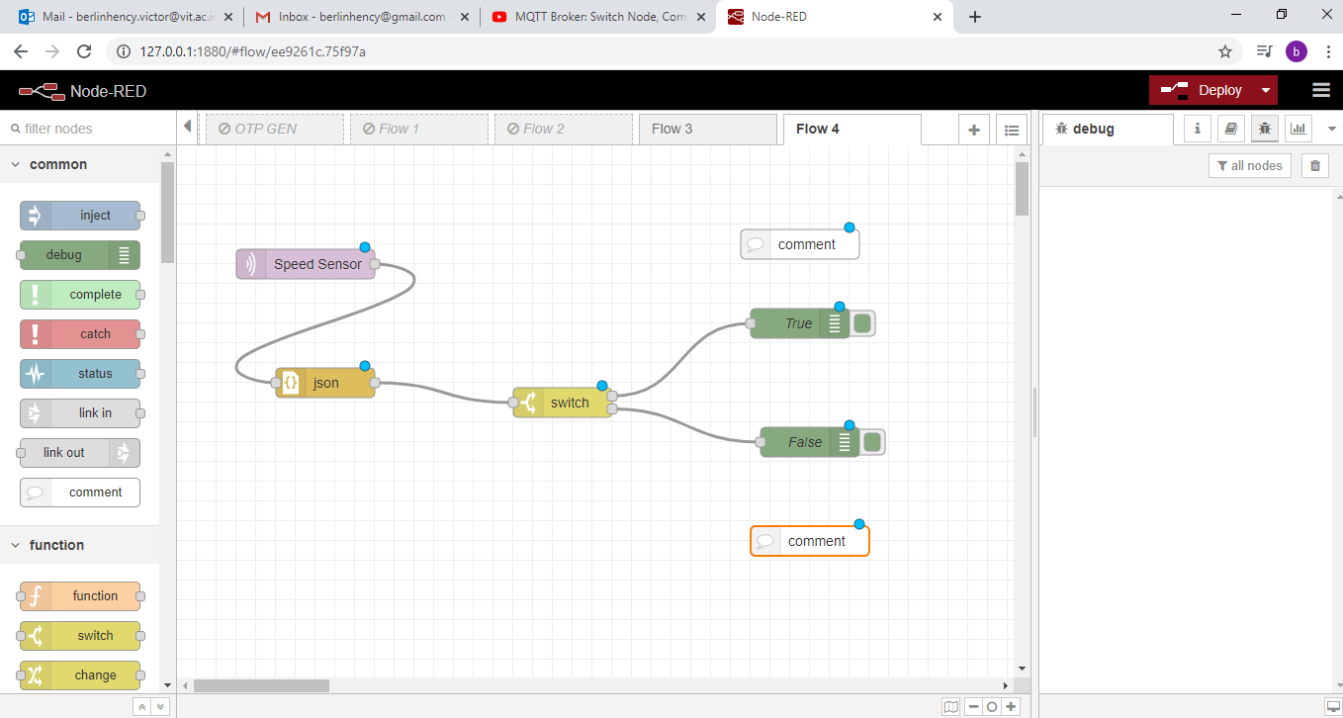
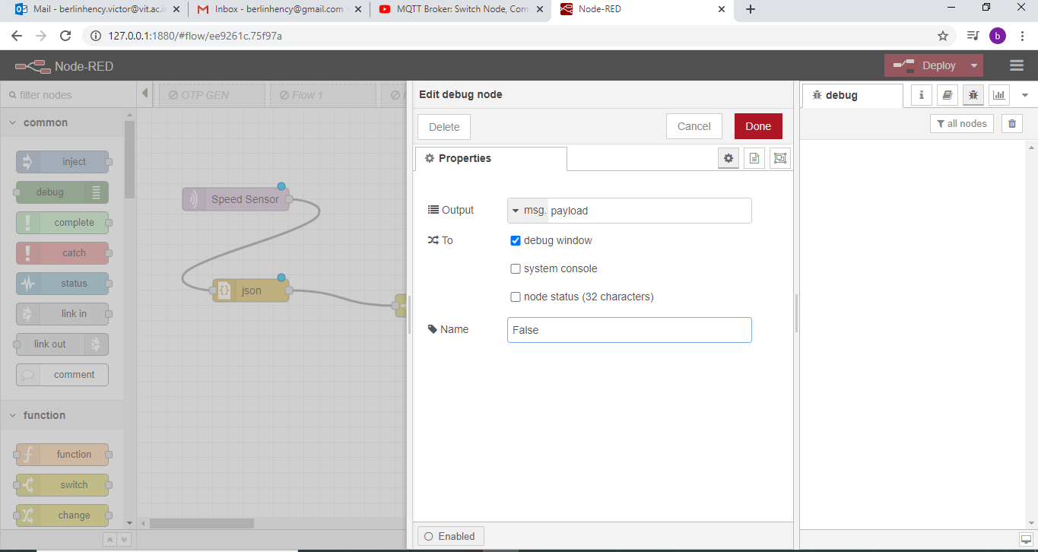

Slide 14
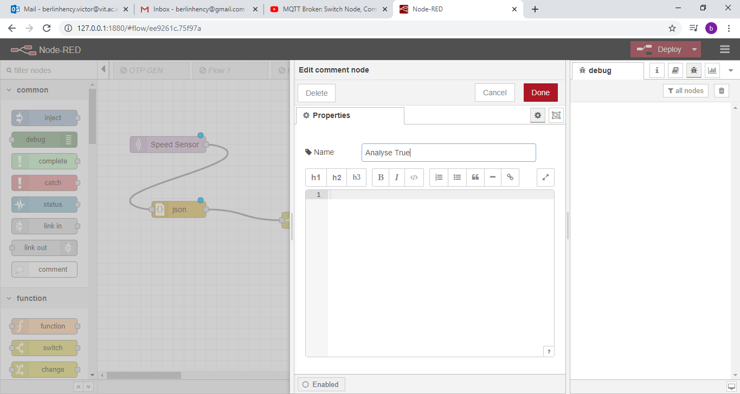
Configure Comment Node

Slide 15
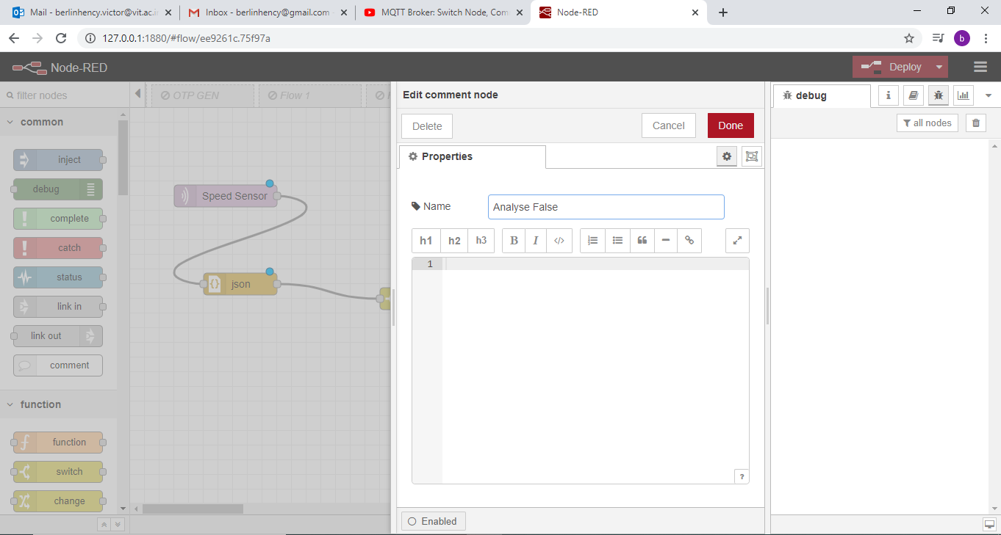

Slide 16
HiveMQ
http://www.hivemq.com/demos/websocket-client/

Slide 17
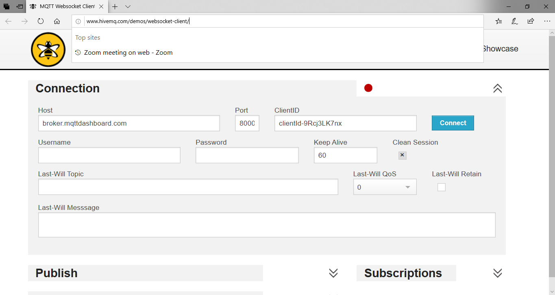
Click Connect

Slide 18
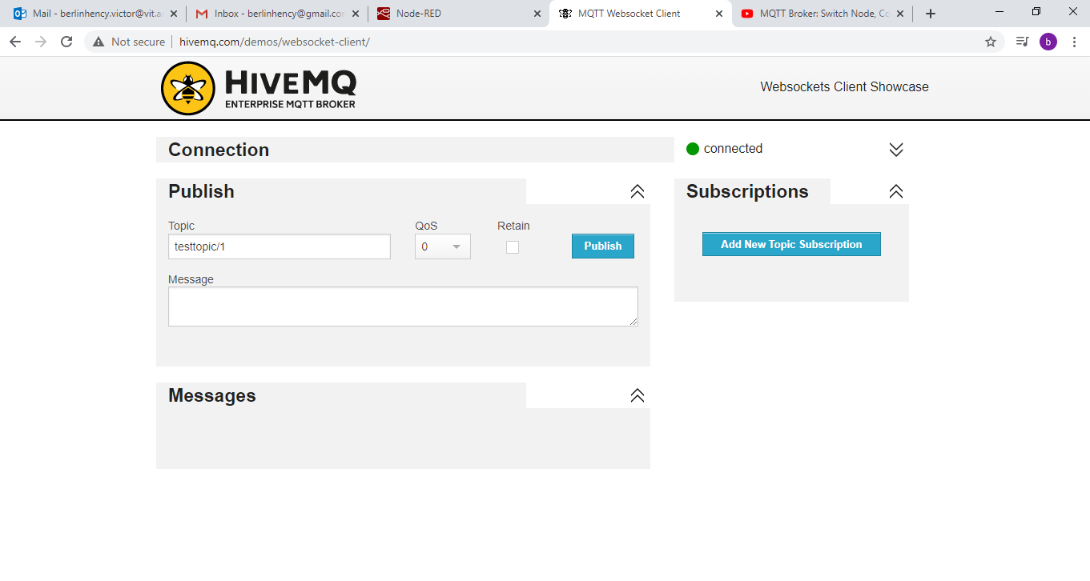

Slide 19
Type message
{"analyse":false,"value":10}

Slide 20
Node red
Deploy

Slide 21
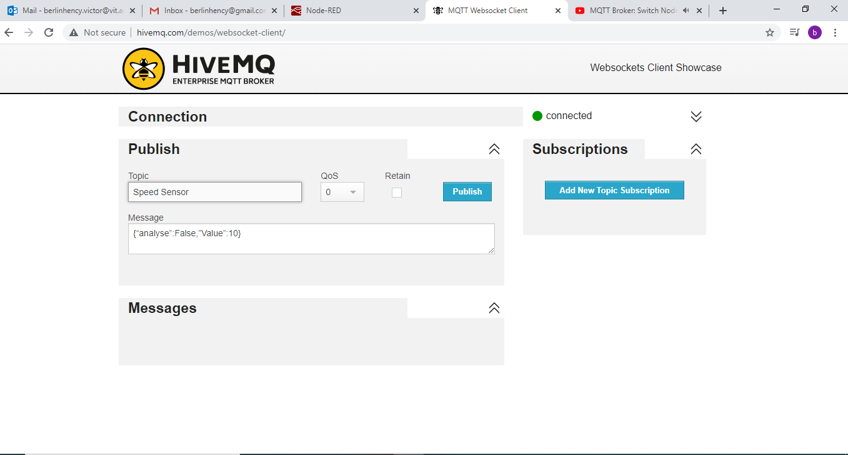
Click publish

Slide 22
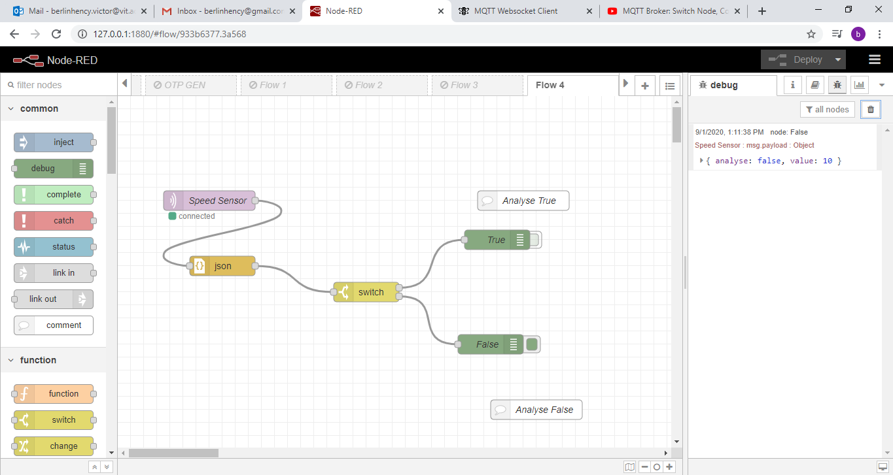

Slide 23
{"analyse":true,"value":10}

Slide 24
Deploy
Publish

Slide 25
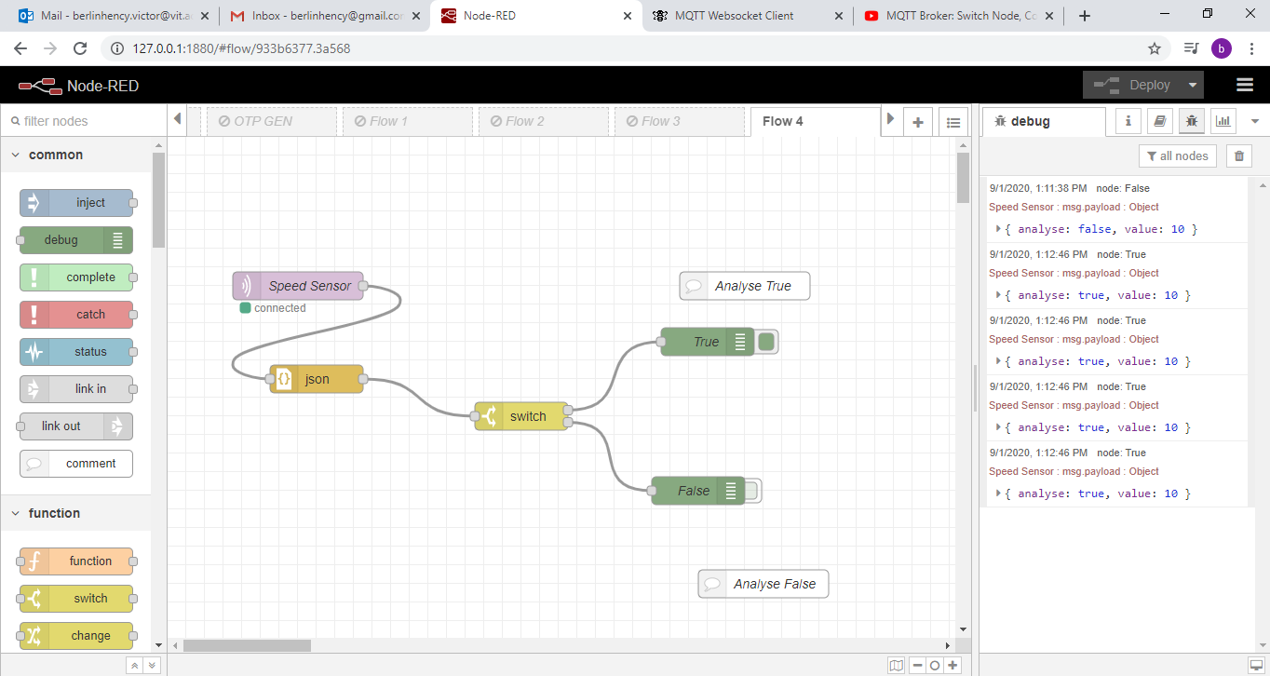

Slide 26
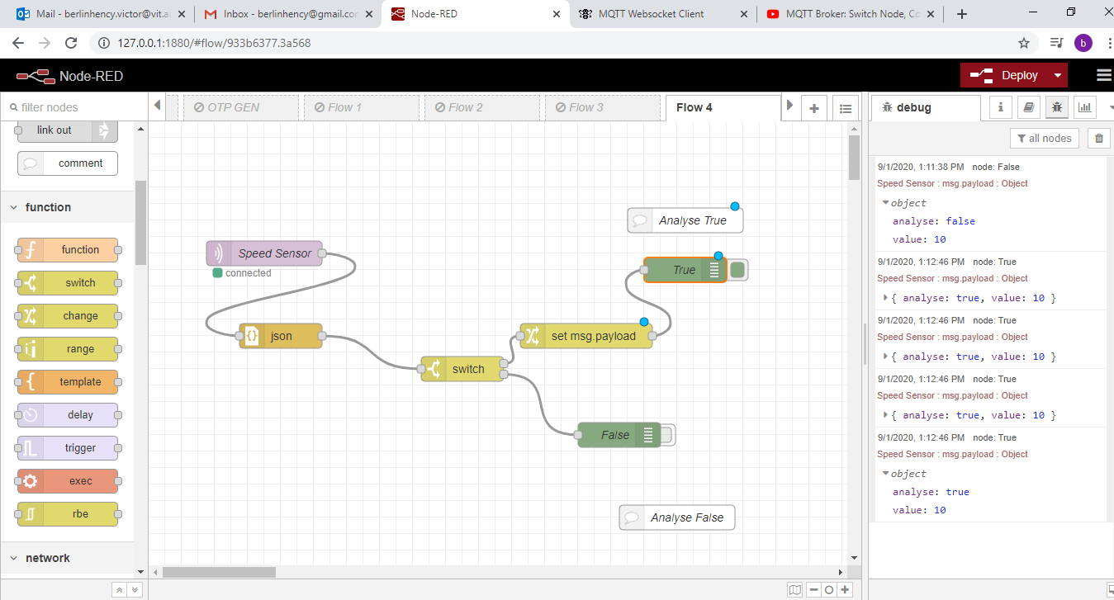
Insert Change node

Slide 27
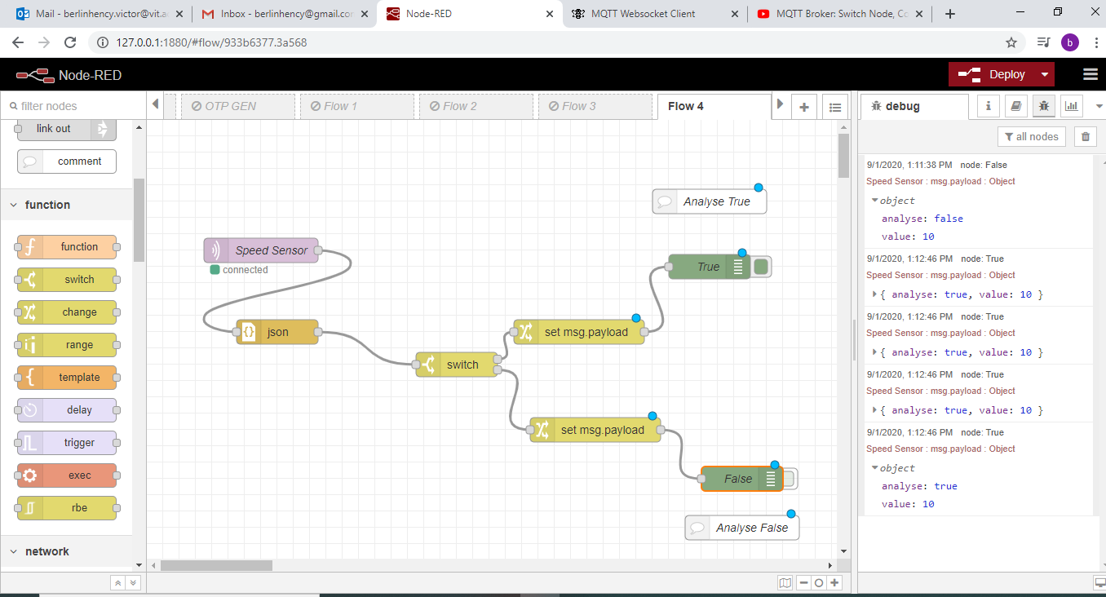

Slide 28
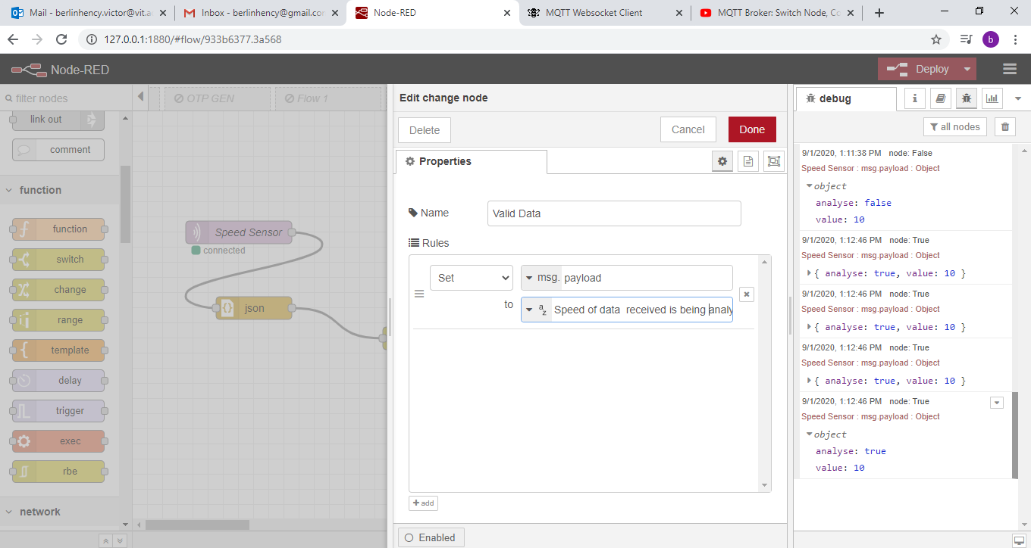
Configure Change Node1

Slide 29
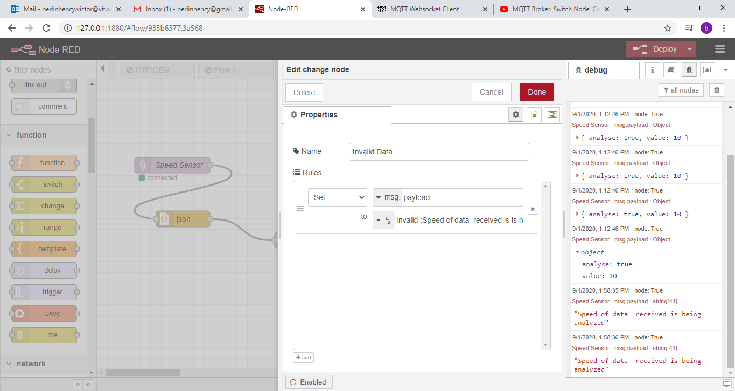
Configure Change Node2

Slide 30
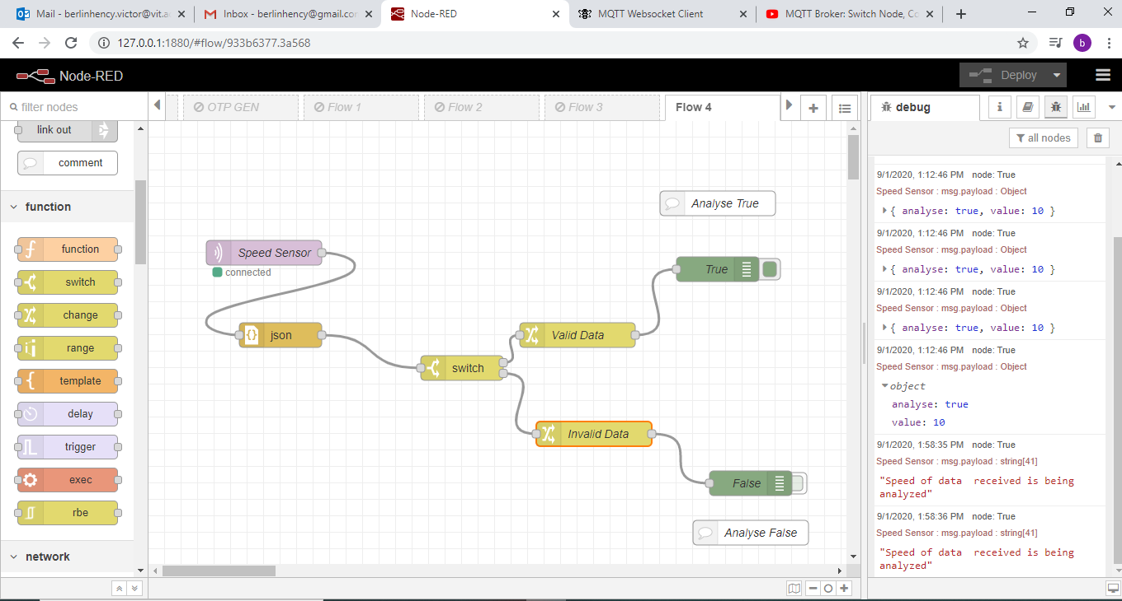
Deploy and publish

Slide 31
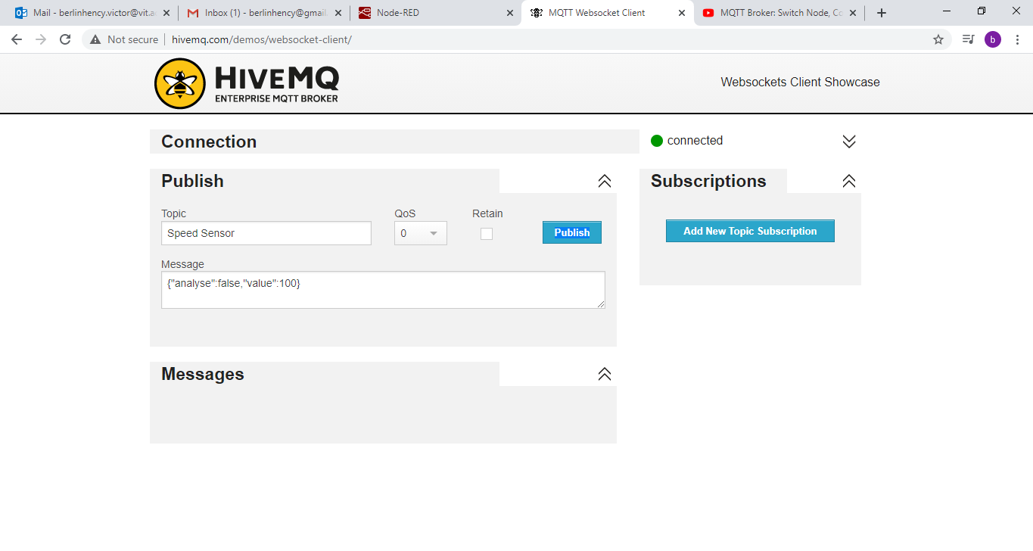

Slide 32
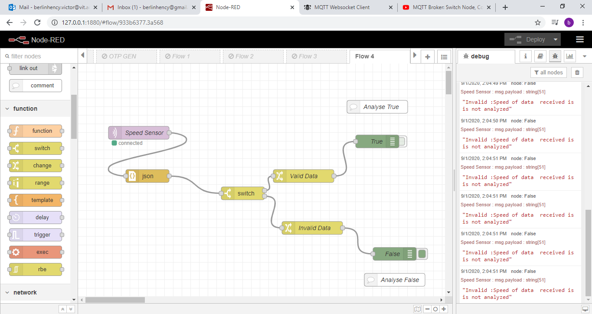
Deploy and publish

Slide 33
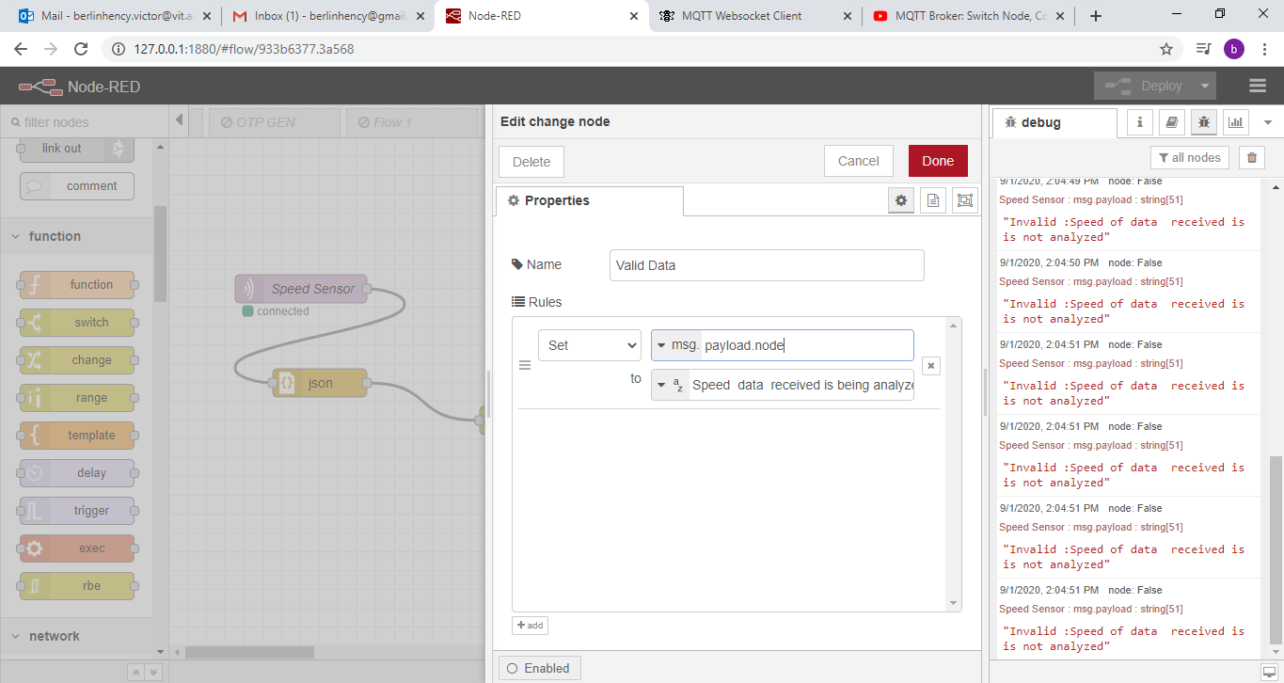

Slide 34
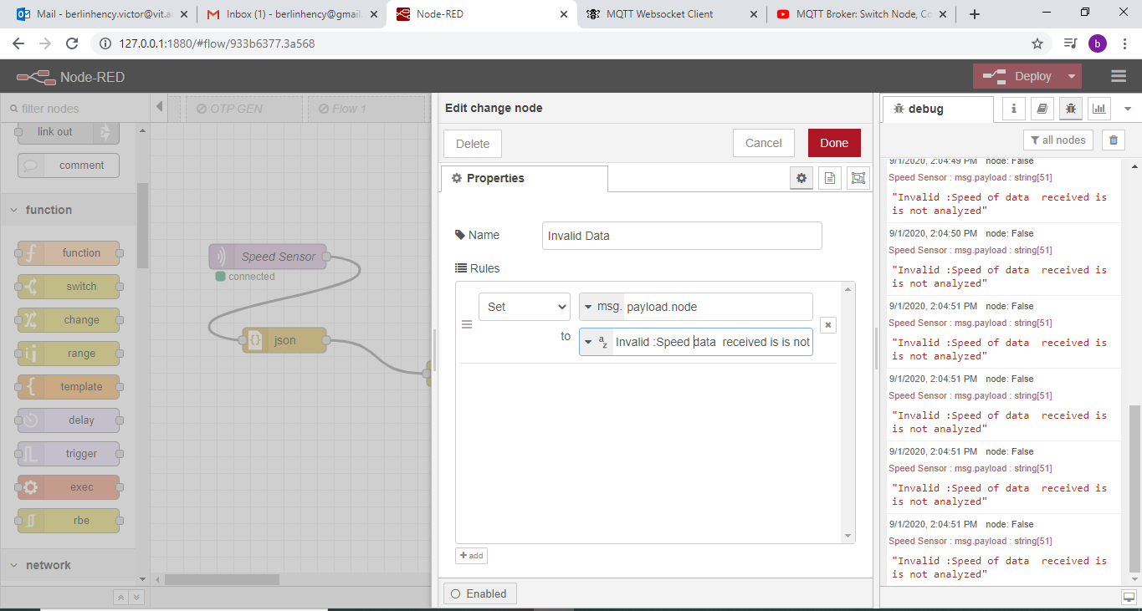

Slide 35


Slide 36
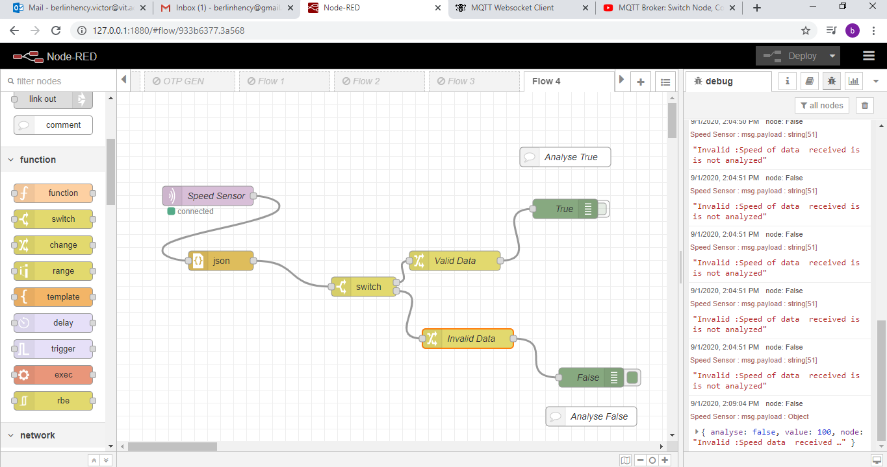
Deploy Publish – To display all detail

Slide 37
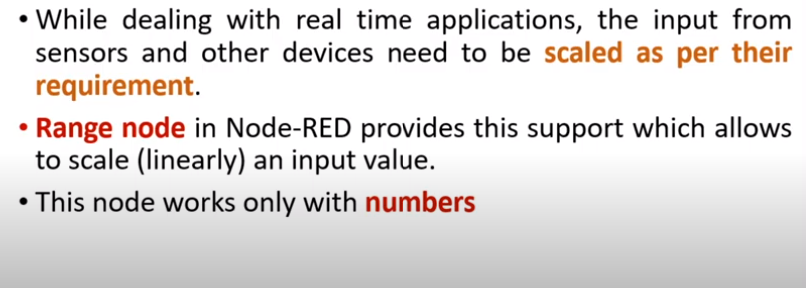
Range Node

Slide 38
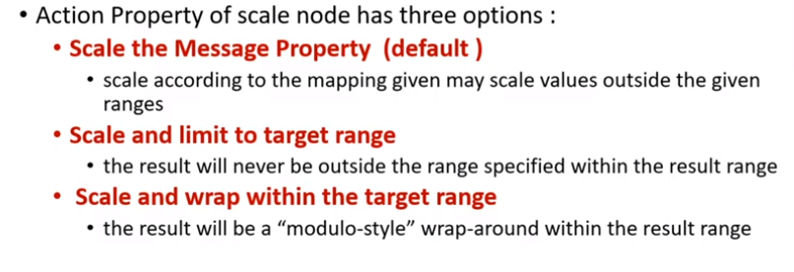
Range Node

Slide 39
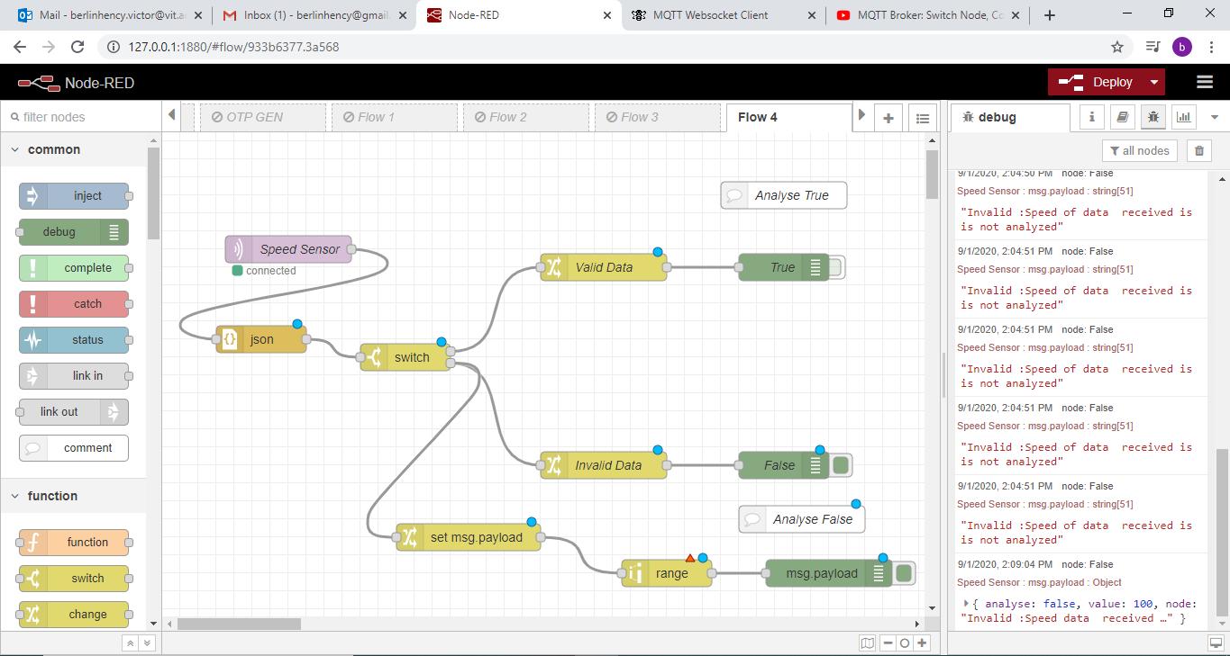
Insert change node range node and debug node

Slide 40
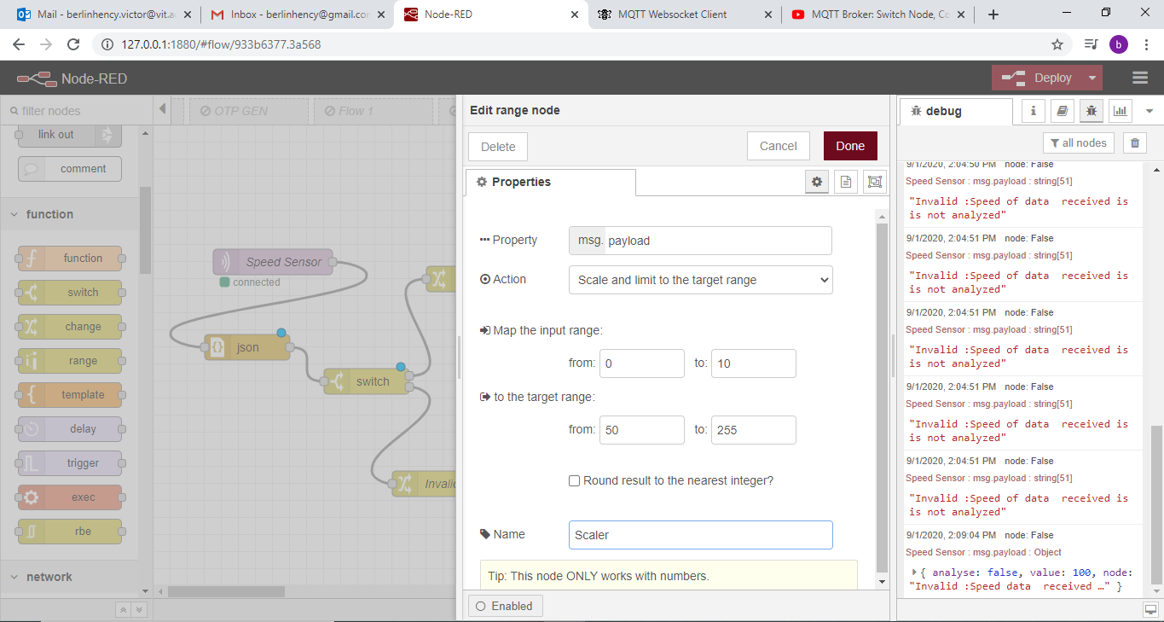

Slide 41
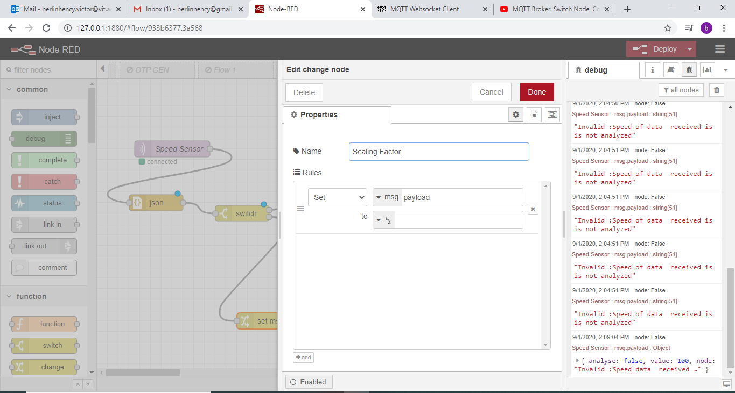

Slide 42
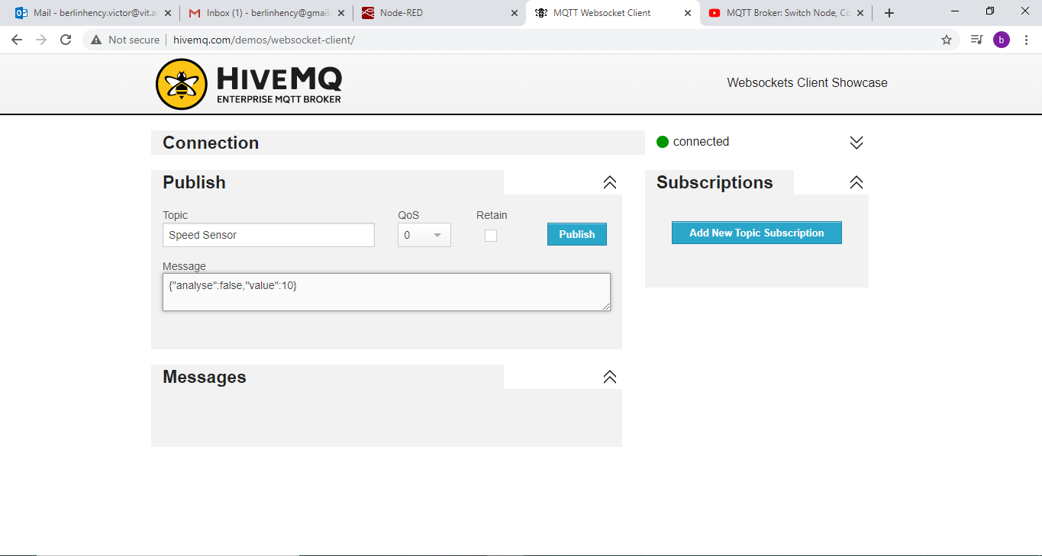
Deploy and publish

Slide 43
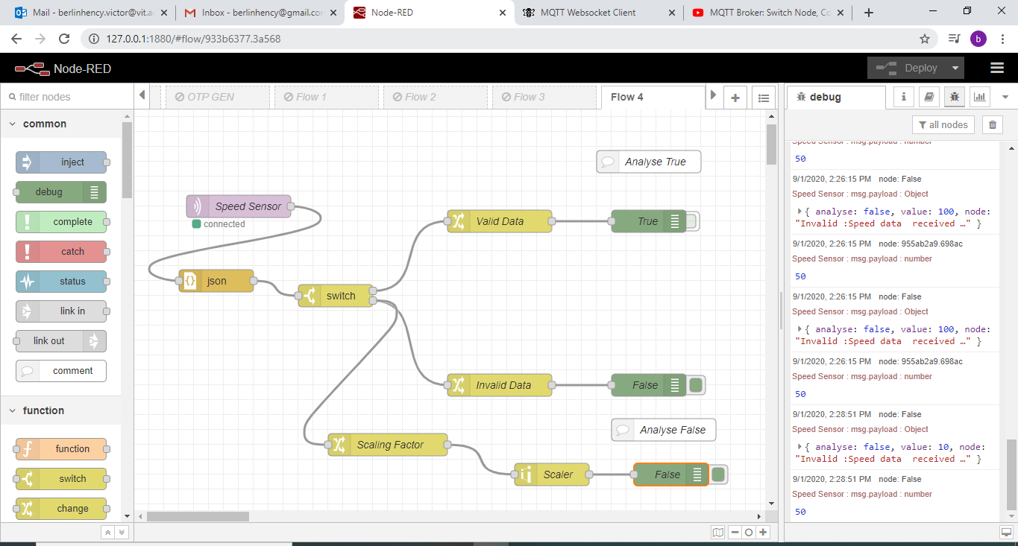

Slide 44
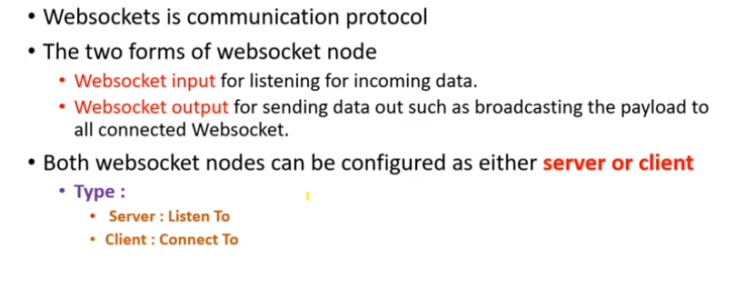
Websocket

Slide 45
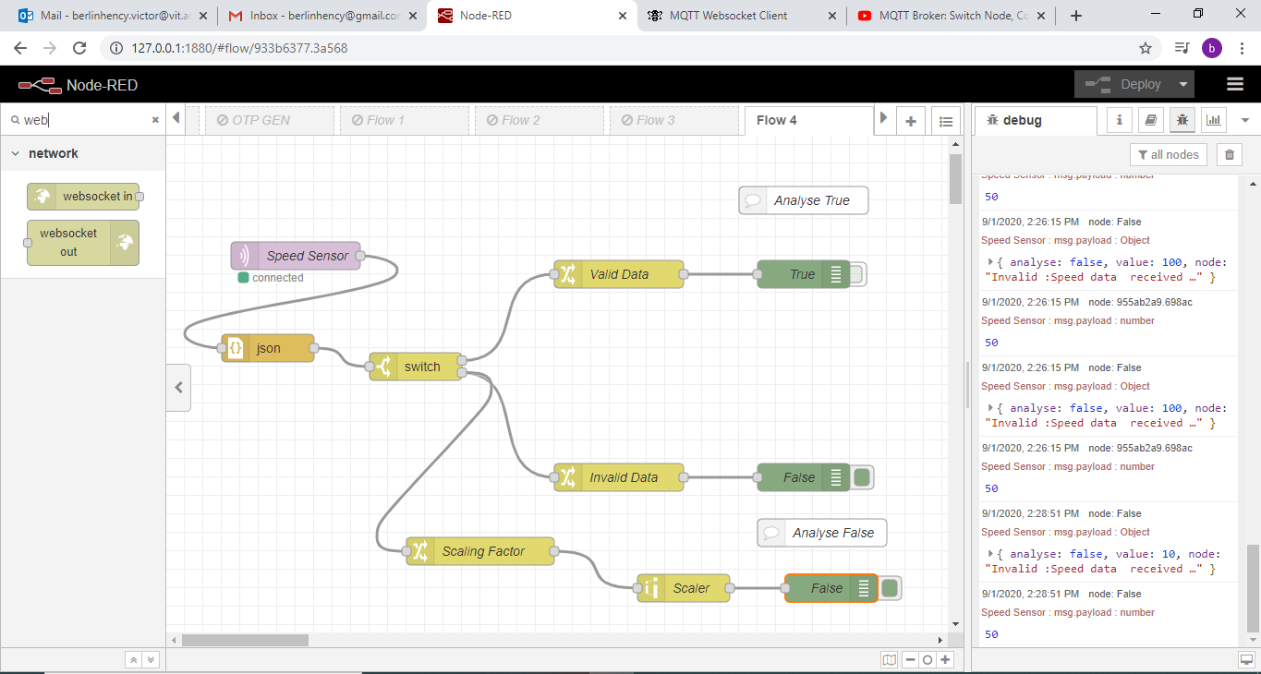

Slide 46
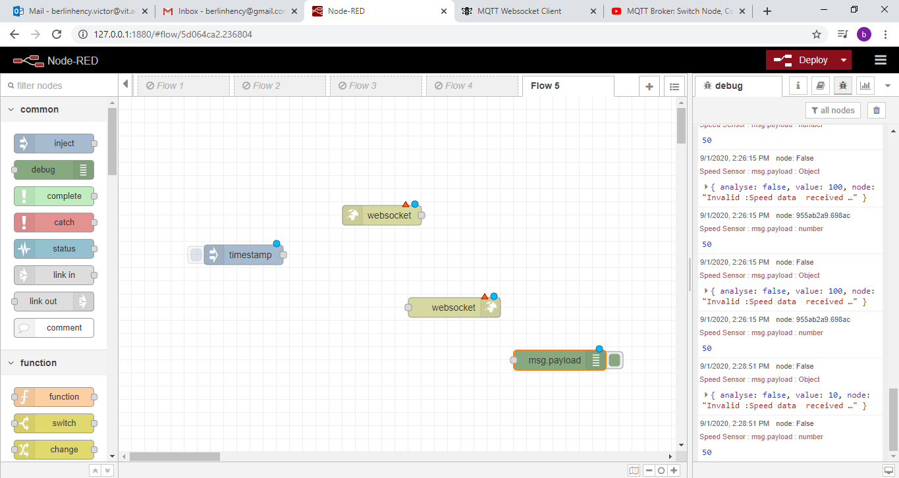
Insert inject node websocket in node websocket out node and debug node

Slide 47
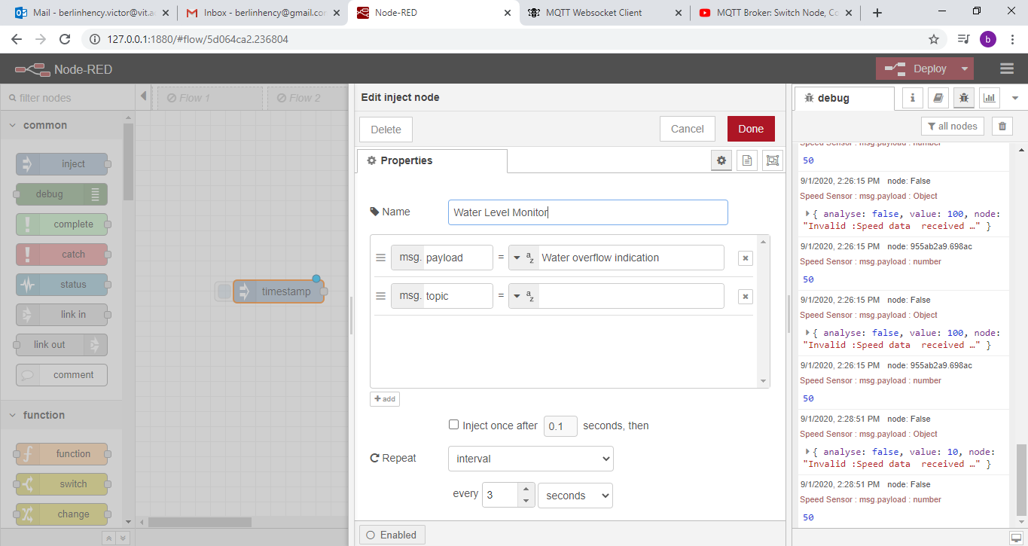

Slide 48
Get url from
https://www.piesocket.com/websocket-tester
wss://demo.piesocket.com/v3/channel_1?api_key=oCd

Slide 49
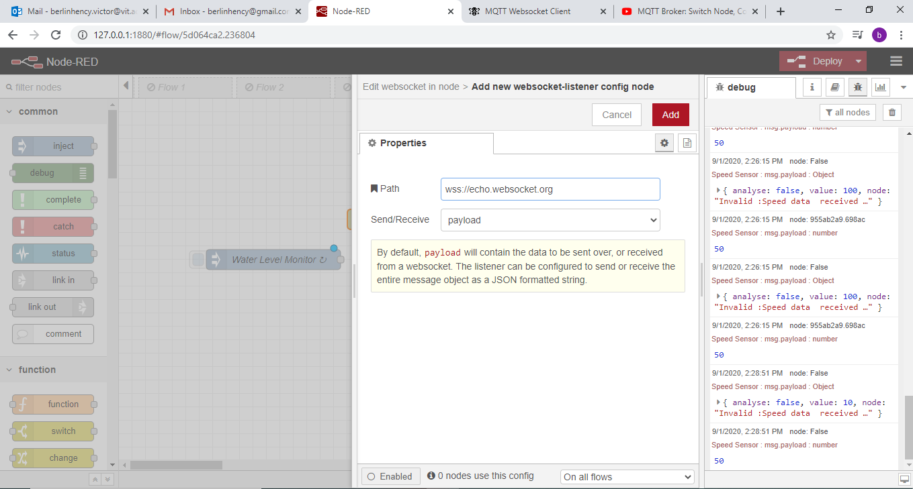

Slide 50
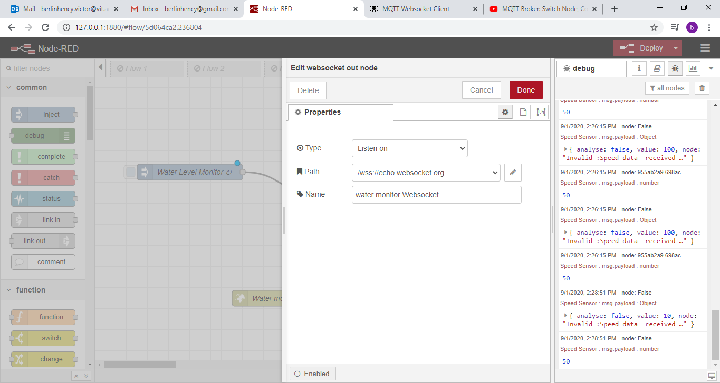
wss://demo.piesocket.com/v3/channel_1?api_key=oCd

Slide 51
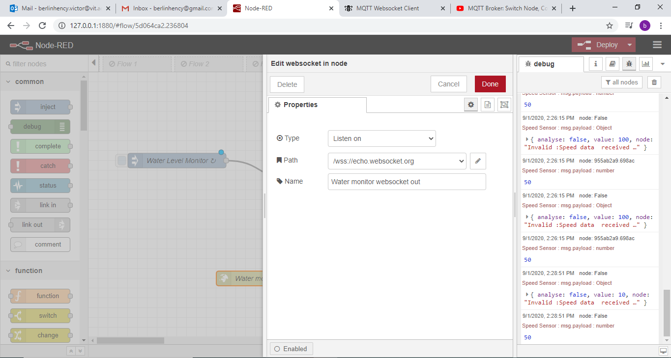

Slide 52
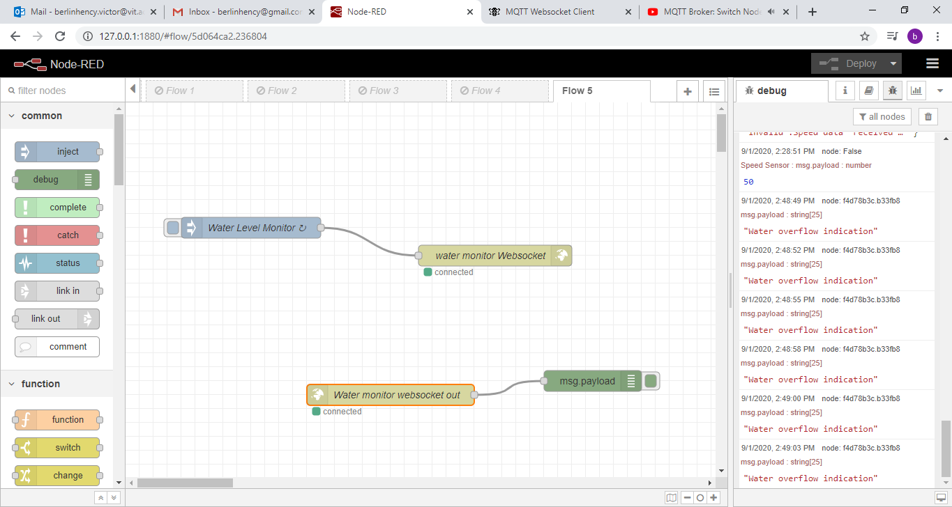
Deploy

Slide 53
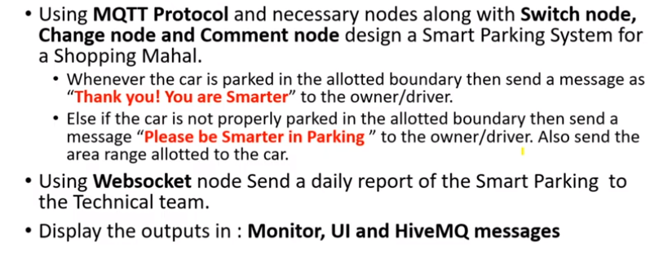
Task

Slide 54
Thank You

